Slide 1
Module 6: Co-Processor

Slide 2
ALP Programming with 8087
Write a program to add three numbers and store the result.
Program
finit → Initialize the coprocessor to start at the beginning of the stack
fld X → Load X into ST(0); ST(0) = X
fld Y → ST(0) = Y, ST(1) = X
fld Z → ST(0) = Z, ST(1) = Y, ST(2) = Z
fadd ST(1) → Add Y and Z and store the result in ST(0)
fadd ST(2) → Add X and Y+Z and store the result in ST(0)
fst sum → Store the added result in the memory location named ‘sum’

Slide 3
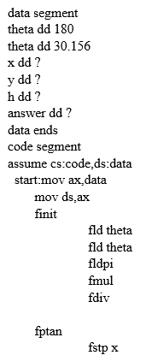

2. Write a program to verify the equation $\sin^{2}x+\cos^{2}x=1$, for any given value of ‘x’.

Slide 4
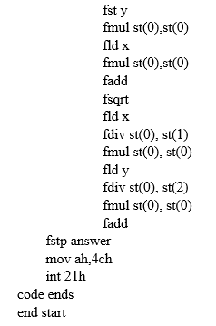

Slide 5
Weblinks
http://www.bitsavers.org/pdf/intel/ISIS_II/121703-003_ASM86_Language_Reference_Manual_Nov83.pdf
https://gist.github.com/tanayseven/3901640

